Slide 1
Application Rationalization & PADU Implementation
Vikas Anand

Slide 2
What is Application Portfolio Rationalization
It is a process of defining and classifying Applications into different categories(PADU)

Slide 3
Steps of APR
Clarify Vision
Assess Current State
Define Future State
Build Road Map
Establish Governance
Execute Program

Slide 4
Step 1 – Clarify Vision
Clarify Vision
Assess Current State
Define Future State
Build Roadmap
Establish Governance
Execute Programs
Key Deliverables | Program Charter Financial Model Capabilities Model Strategy Map Operating Model Information Assets Intellectual Assets
Key Tasks
Identify business and technology: Goals Drivers Strategies Products Domains Domain owners Develop business and technology domain frameworks Develop the business capability model
Key Resources | Business Funding Business Sponsor Technology Sponsor Application Architect
Notes:
The objective of this activity is to develop a common, non-ambiguous understanding of the organization’s Business Architecture.
This information is used throughout the architecture development process to:
Identify the business and IT owners to sponsor and participate in the architecture review and transformation process
Identify and prioritize the areas in which to focus your rationalization efforts
Capture business capabilities and/or business processes that will be used to identify redundancy and gaps in your applications portfolio
Align IT strategies/initiatives with business strategy, goals, and objectives

Slide 5
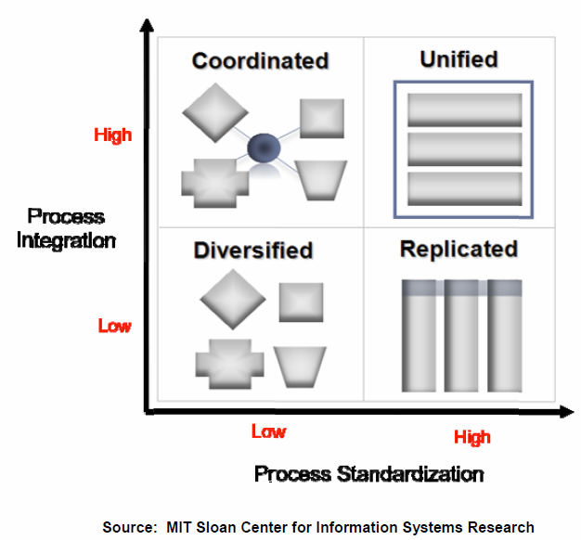
Operating Model
Integration links the efforts of organizational units through shared data. This sharing of data can be between processes to enable end-to-end transaction processing, or across processes to allow a company to present a single face to customer.
Standardization of business processes and related systems means defining exactly how a process will be executed regardless of who is performing the process or where it is completed
Notes:
Understanding the company’s current and desired future-state operating model helps you to determine how to apply rationalization within the organization to achieve the desired results. For example, a company with a diversified operating model would likely perform a rationalization of processes and applications within each business unit individually with the objective of optimization to improve efficiency. A company with a coordinated operating model would likely rationalize information assets with the objective of establishing a single version-of-the-truth and providing easy access to key information across the enterprise.

Slide 6
Step 2 – Assess Current State
Clarify Vision
Assess Current State
Define Future State
Build Roadmap
Establish Governance
Execute Programs
Key Deliverables | Applications Inventory and Heat Map Technology Inventory and Heat Map Data Store Inventory and Heat Map Business Capability Assessment Application / Technology Architecture Can be delivered separately depending on the size and complexity of the platform Data Architecture Domain metrics, issues, risks, opportunities IT Organization Chart PMO Structure Architecture Maturity Model Capabilities Maturity Model
Key Tasks
Identify domain level metrics Inventory and Score existing applications Inventory and Score existing technologies Inventory and Score existing data stores Map applications to business domains & capabilities Map technologies to technology domains & architecture Map data stores to business domains & architecture Build application clusters Identify in-progress initiatives and their impact to current state Identify domain level issues, risks and opportunities Perform architecture maturity assessment Perform capabilities maturity assessment
Key Resources | Subject Matter Expert Governance Master
Notes:
Identify domain level metrics
Application cost
Application complexity
Application maturity
Application health
Strategic fit of functionality
Business criticality
Inventory and Score existing applications
Inventory and Score existing technologies
Inventory and Score existing data stores
Map applications to business domains & capabilities
Map technologies to technology domains & architecture
Map data stores to business domains & architecture
Build application clusters
Identify in-progress initiatives and their impact to current state
Identify domain level issues, risks and opportunities
Perform application maturity assessment
Perform capabilities maturity assessment

Slide 7
Step 2 – Assess Current State – Worksheets and Tools
Capabilities Assessment Template
Capabilities Assessment Template

Slide 8
Step 2 – Assess Current State – Inventories
Technology Inventory
Application Inventory

Slide 9
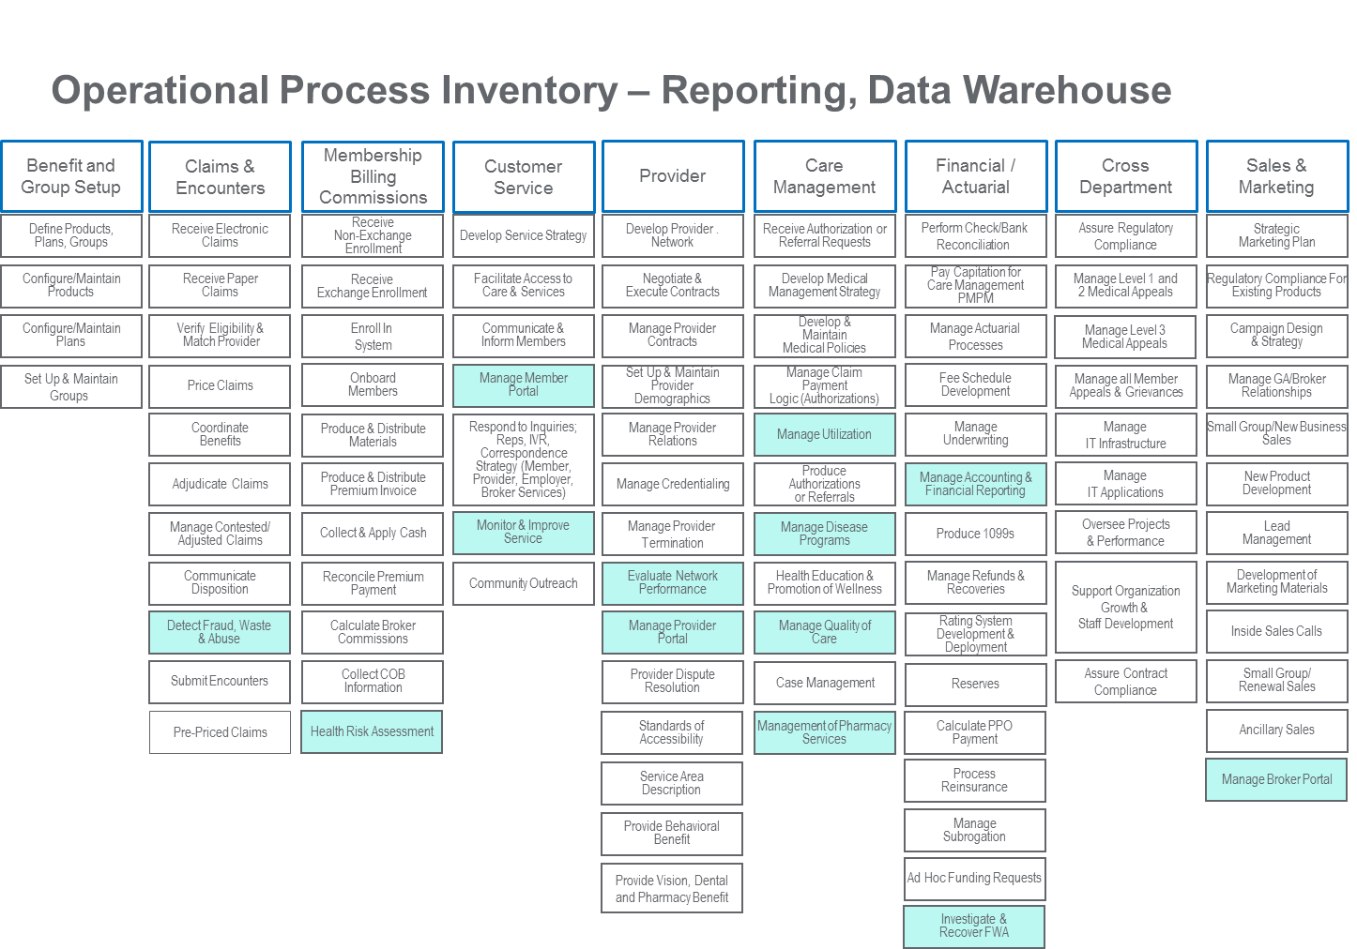
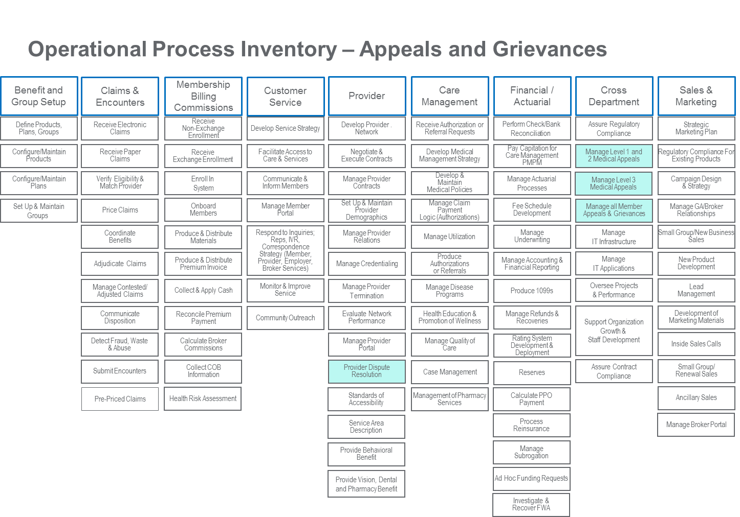
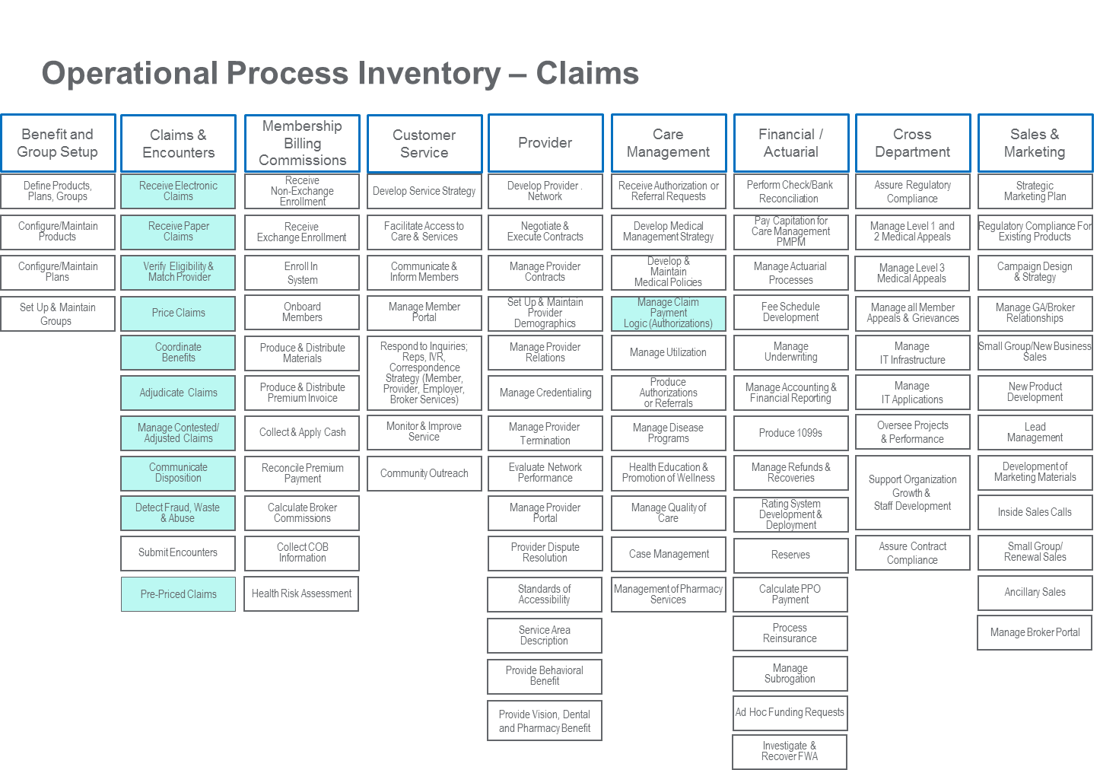
Step 2 – Assess Current State – Application Clusters
Notes:
Once you have captured the pieces of the portfolio, they must be mapped to the
business functions that they support.
The mapping does not necessarily need to be at a very granular level. Level 1 or
2 business process flows can be used for this effort. You could also use a simple
matrix showing the applications and which business functions they support.
It is especially important to capture where a particular business process is
duplicated. Through an iterative process, when new business processes are
discovered relative to a given portion of the portfolio, the remainder of the
portfolio should be analyzed (at least at a summary level) to determine if those
pieces are also supporting this process. Think in terms of a company that has
more than 1 ERP system. While the multiple system may each support unique
business processes, it is more likely that there is overlap among them.
Spreadsheets or a tool like Treux can be used to capture the inventory list to
business process mapping.

Slide 10
Step 2 – Assess Current State – Capability Model

Slide 11
Capabilities Maturity Model
Optimizing
Continuous
Improvement
Implement continuous proactive improvements to achieve business goals
Defect prevention
Technology change management
Process change management
Quantitative process management
Software quality management
Software configuration management
Managed
Quantitative
Management
Manage process and results quantitatively and exploit benefits of standardization
Organizational process focus
Organizational process definition
Training programs
Integrated software management
Software product engineering
Intergroup coordination
Peer reviews
Design
Code
Compile
Test
Rework
Defined
Institutionalized
Processes
Develop standard processes, measures, and training for product and service offerings
Repeatable
Individual Initiative
Build disciplined work unit management to stabilize work and control commitments
Requirements management
Software project planning
Software project tracking & oversight
Software subcontract management
Software quality assurance
Initial
Heroic Efforts
Motivate people to overcome problems and just “get the job done”
Notes:
Level 0 – Initial
At this level, the organization lacks a stable environment for the implementation. Values are given to implementation aspects and implementation factors in an ‘ad hoc’ fashion and there is no interconnection between them. Organizational processes and goals are not considered centrally during implementation projects and communication hardly takes place. The overall implementation lacks structure and control and its efficiency depends on individual skills, knowledge and motivation.
Level A – Repeatable
Activities are based on the results of previous projects and the demands of the current one. Implementation aspects are considered during implementation projects. Project standards are documented per aspect and the organization prevents any deviant behavior or actions. Previous successes can be repeated due to stabilized planning and control.
Level B – Defined
The process of implementing is documented throughout the organization rather than per aspect. Projects are carried out under guidance of project operation standards and an implementation strategy. Each project will be preceded by preparations to assure conformity with the processes and goals within the organization.
Level C – Managed
Projects are started and supervised by change management and/or process management. Implementing becomes predictable and the organization is able to develop rules and conditions regarding the quality of the products and processes (performance management). Deviating behavior will immediately be detected and corrected. The implemented IT-solutions are predictable and of high quality and the organization is willing and able to work with it. At this level, implementing has become a ‘way of life’.
Level D – Optimizing
The whole organization is focusing on the continuous improvement of the implementation processes. The organization possesses the means to detect weaknesses and to strengthen the implementation process proactively. Analyses are carried out to find the causes of error and mistakes. Each project will be evaluated after closure to prevent recurrence of known mistakes.

Slide 12
Step 3 – Define Future State
Clarify Vision
Assess Current State
Define Future State
Build Roadmap
Establish Governance
Execute Programs
Key Deliverables | Rationalization Model Rationalization Map Opportunity Domain Grid and Heat Map Future state business capability model Future state technology architecture Future state data architecture
Key Tasks
Analyze the value of the inventories leveraging the suitable optimization frameworks: Strategic Functional Technical Financial Document desired future state for each domain – addressing Goals Drivers Strategies Products Issues Risks Opportunities Document desired future state technologies Document desired future state data architecture
Key Resources
Notes:
Create views across all layers of an Enterprise Architecture framework
Business
Application
Information
Technology
Conform to architecture principles and standards as defined in the architecture vision.
Employ relevant industry reference models and architectures to facilitate development,
and reduce risk
Identify current state to future state gaps and changes (recommended action for each
application resulting from application portfolio analysis)
Capture benefits, risks, and mitigation measures for each of the changes
Align with business strategy, goals, and objectives as defined in the architecture vision
Align with operating model as defined in the architecture vision
Provide recommendations to address the opportunities-for-improvement identified in the
EA capability/maturity assessment

Slide 13
Define Future Application Landscape
Business Strategy
EA Principles
Business Requirements
& Objectives
Architectural Principles
Industry Best Practices & Models
EA/Solutioning Process & Guidance
Business Architecture
Business Process & GRC Model
EA Views
Application Architecture
EA Artifacts
Capability & Service Descriptions
Information Architecture
Data/Info Objects & Models
Technical Architecture
Technology Standards & Reference Models
Notes:
Sample Principles
Business Architecture Principles
Cost Optimization – Low cost across the lifecycle of a product or service is a compelling value proposition for targeted customer segments.
Corporate Environment Responsibility – Going green is not only crucial from a social responsible and moral standpoint, it also has economic benefits. Eco-efficiency, eco-transparency and eco-innovation are critical for a greener future.
Enterprise Balance – This principle embodies “service above self” and decisions made from an enterprise wide perspective have greater long term benefit than tactical decisions made from a particular organizational perspective.
Application Architecture Principles
Common Use Applications – Duplicative capability is expensive and proliferates conflicting data.
Technology Independence – Independence of applications from the underlying technology allows applications to be developed, upgraded, and operated in the most cost-effective and timely way.
Adherence to Open Standards - promote business / IT agility, reduce risk and achieve a lower overall TCO than proprietary applications.
Common Development Methodology and Tools - Standard development methodologies increase the likelihood of high quality results and promote reusable components.
Replace Obsolete Applications – Every application has a limited useful life span. Beyond this life span, the application becomes functionally deficient and costly to operate and maintain
Information Architecture Principles
Data Quality – Systems that consistently carry stale and incomplete data pose risk and inefficiency to the business and should be streamlined to only carry the information that it can realistically ensure quality for.
Master Data Management - Multiple sources of data cause data quality/integrity issues that greatly increase system complexity and overall cost, while reducing agility.
Standard Data Exchange Format – Exchanging data in standardized representations lowers integration cost of supporting new and changing data model requirements.
Technology Architecture Principles
Adherence to Open Standards - Standards compliance enhances flexibility.
Platform Standardization – simplifies maintenance and lowers support costs.
Availability - Loss of business service can be very costly and can often be underestimated.
Performance and Scalability - Responsive systems, with sufficient capacity, enable business success.
Service Level Objectives - If the Technology does not allow the business to meet its Quality of Service (QoS) objectives, then the business will suffer.
Governance Principles
Strategic Focus - Aligning the Enterprise Architecture with the business strategy increases the value of IT to the business.
Accountability - Accountability structures encourage compliance with the Enterprise Architecture.
Compliance to Enterprise Architecture - An effective Enterprise Architecture needs to be a guide for all IT projects
Wide Participation - Wide participation by stakeholders throughout the enterprise ensures that the Enterprise Architecture will meet the optimal requirements of the enterprise, not just a select group of LOB requirements.
Quantitative Decision Making - Utilizing quantitative processes and metrics provides a consistent and equitable means of evaluating decisions and increases the effectiveness of Enterprise Architecture Governance.

Slide 14
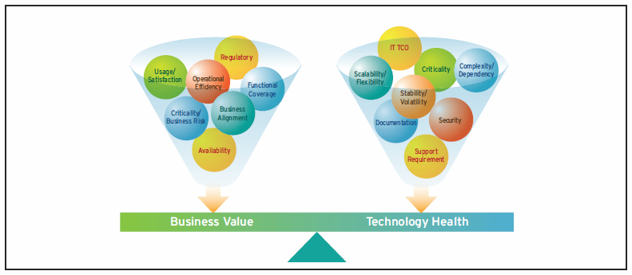
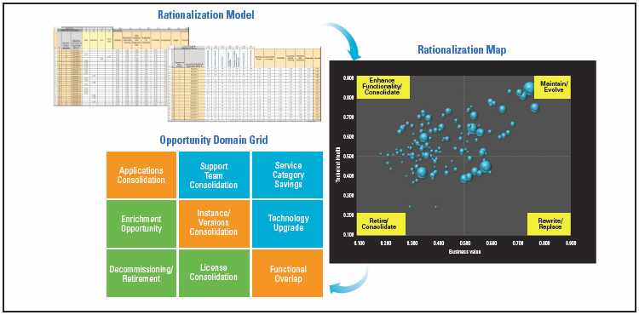
Step 3 – Define Future State - Analysis
Quantify value of each application by applying relative value based on metrics:
Application Total Cost of Ownership Application Complexity Application Maturity Application Health | Strategic Fit of Functionality Business Criticality Risk
Identify Application Rationalization opportunities:
Retiring aging and low-value applications
Modernizing aging and high-value applications
Eliminating redundant applications
Standardizing applications on a common technology platform and version
Consolidating applications – either physically, logically, or both
Wave 1: Immediate Rationale Identify “quick wins” in the application rationalization opportunities The list of quick wins would primarily be retirement opportunities | Wave 2: Near Term Rationale Identify application rationalization opportunities that can be achieved in the near term The list of near-term opportunities would primarily be integration possibilities | Wave 3: Long Term Rationale Identify application rationalization opportunities that can be realized in the longer term The list of longer term improvements would primarily be technical remediation possibilities such as rewrite, replace, etc.

Slide 15
Step 4 – Build Roadmap
Clarify Vision
Assess Current State
Define Future State
Build Roadmap
Establish Governance
Execute Programs
Key Deliverables | Prioritized Initiatives / Projects Functionality Driven Transitional Architecture Business Process Driven Transitional Architecture Business Implementation Roadmap Technology Implementation Roadmap
Key Tasks
Conduct gap analysis between current and future state for each domain Conduct cross domain impact analysis Consolidate opportunities into initiatives/projects Understand the interdependencies across the optimization opportunities Identify and prioritize programs to achieve desired future state Identify and prioritize programs to eliminate duplication Identify timelines and milestones Identify functional teams
Key Resources | Project Manager

Slide 16
Step 5 – Establish Governance
Clarify Vision
Assess Current State
Define Future State
Build Roadmap
Establish Governance
Execute Programs
Key Deliverables | EA Governance roles and responsibilities matrix Application integration and mitigation procedures Business cases for unfunded high priority programs
Key Tasks
Assess and recommend Risk Management Ensure alignment with auditing, financial, and regulatory structures and processes Establish domain roadmap governance Integrate domain roadmap governance with capital governance Analyze current capital plans against prioritized programs list Identify unfunded high priority programs Develop and submit business cases for unfunded high priority programs
Key Resources

Slide 17
Step 6 – Execute Programs
Clarify Vision
Assess Current State
Define Future State
Build Roadmap
Establish Governance
Execute Programs
Key Deliverables | Business Value Discovery Matrix Funded programs and projects successfully deployed Updated future state business capability model Updated future state technology architecture Updated future state data architecture
Key Tasks
Define future state costs / Risks Estimate EA roadmap investments Perform cost / benefit analysis Build the Business Case Document Execute funded programs and projects Update future state business capability model Update future state future state technology architecture Update future state future state data architecture Established funding PM and Resources assigned per initiative Instantiate projects in multiple phases based on: Immediate return Near Term benefits Long Term benefits Introduce projects into existing SDLC framework
Key Resources

Slide 18
Final Step of the Business Case Development
Architecture Vision
Current State
Future State
Strategic Roadmap
Governance
Business Case
Strategy Map Customer Perspective Financial Perspective Business Model Value Proposition Cost Structure Revenue Stream Business Capability Model Operating Model Level of Business Process Integration and Standardization | Understanding the Existing Business Case Culture Identify Existing Goals / Drivers Priorities Measures used Metrics preferred Monetization numbers Assess Against Benchmarks | Agree to Architecture Future State Quantifiable measures Metrics for calculation Non-tangible or soft criteria | Business Value Identify Timelines and Milestones for Measurement | Identify alignment with existing auditing and other financial structures and processes | Define Future State Costs/Risks Estimate EA Roadmap Investment Perform Cost/Benefit Analysis Build the Business Case Document
Business Case Development
Activities
and
Artifacts
Work
Effort

Slide 19
PADU Implementation
Application
Business
Technology
Commercial Software
Hardware

Slide 20
Application PADU Criteria
Dimension | (P)referred > Invest | (A)cceptable > Maintain | (D)iscouraged > Dis-Invest | (U)nacceptable > Decomm
Technology PADU as an input | Technologies supporting have mostly preferred Tech PADU rating Viable / strategic vendor fit for commercial software | Technologies supporting have a mix of P/A Tech PADU rating Financial stable vendor for commercial software | If app has D tech supporting it, the app rated D if it cannot be modernized Vendor strategically at odds with our overall architecture for commercial software | If app has any U tech supporting it, the app rated U if it cannot be modernized Vendor financially not viable or out of business for commercial software
Architecture Fit | Modern/supported technology Integrates well with existing tools and processes | Systems meet Service Level Agreements most of the time. Underlying systems are in a monitored production environment | May be stability issues or technical health issues with the underlying systems | Heritage technologies Does not integrate with other tools and processes End-of-life within 3 years
Data Mgmt. | All desired data is readily available when needed, with controlled high quality and robust metadata. It is appropriately structured for efficient and flexible use, is actively governed (e.g., master data management), | Most data is readily available when needed, with key metadata attribution and little to no quality issues. It is partially governed, generally from an enterprise perspective, and meets most compliance needs | Data may not be readily available and metadata is not recorded. Determining where the data resides is time-intensive and dependent on knowing who to contact. | Data does not exist within the organization and is not readily available externally.
20

Slide 21
Business PADU Criteria
Dimension | (P)referred > Invest | (A)cceptable > Maintain | (D)iscouraged > Dis-Invest | (U)nacceptable > Decomm
User Interface and UI/UX | Easy to Navigate Above 95% usage of all existing features Self explanatory and Training and adoption is less costly Not on legacy platform No requirement for wrappers, BIOTS on top of this application | Moderate to easy navigation Above 75% usage of all existing features Needs some training for new users and operations to adopt. Not on legacy platform Minimal requirement for wrappers, BIOTS on top of this application | Challenges with navigation Less than 50% usage of all existing features Lot of dependency with expertise talent to operate this product/Features On legacy platform Dependency with wrappers and BIOTS on top of this application | Issues with some features and with navigation Less than 50% usage of all existing features Lot of dependency with expertise talent to operate this product/Features On legacy platform Dependency with wrappers and BIOTS on top of this application
TAT of new features | Less than two weeks of TAT for new features to be in production | Less than 4 weeks of TAT for new features to be in production | Lot of complexity to modify the features and takes more than 12 weeks to make changes to the features | More than 6 months to make the changes to the features
Business Functional Fit | 90-100% fit to functional business requirements | 80-90% fit to functional business requirements | 50-70% fit to functional business requirements | <50% fit to functional business requirements
Total cost of ownership | Excellent, well below Market Cost | Good, slightly below Market Cost | Fair, above Market Cost | Poor, well above Market Cost

Slide 22
Commercial Software PADU Criteria
Dimension | Preferred SALES VERSION | Acceptable SUPPORTED | Discouraged EXTENDED SUPPORT | Unacceptable END OF LIFE
Client Functional Fit | 90-100% fit to clients’ functional business requirements Clear client-facing roadmaps to help customers understand where product is going Advancement of the product provides a competitive edge | 80-90% fit to clients’ business requirements Clear client-facing roadmaps to help customers understand where product is going | 50-70% fit to clients’ business requirements Client-facing roadmaps may not exist | <50% fit to clients’ business requirements Client-facing roadmaps may not exist
Support Model & Availability | Software meets client service level agreements 99-100% of the time Both self help and contact center support available | Software general meets client service level agreements most of the time Both self help and contact center support available | May have stability issues or technical health issues with the underlying systems Client is aware we are shifting them to a “premium” support style model | Chronic availability issues SLAs often go unmet / under-met Software not effectively supported End-of-life within1-2 years
Margin Management | Underlying cost structure allows for competitive pricing while still achieving attractive business margins | Underlying cost structure forces parity pricing still achieve acceptable business margins | Premium pricing to incentivize user base to mode to Preferred or Acceptable versions of the solution | Underlying cost structure pushes us to price well above Market Cost
Sales Implications | Becomes the preferred sales version | Supported as part of the sales cycle | Sales team should proceed with caution | Requires exception before initiating new client sales
Technology | Technologies supporting have mostly preferred Tech PADU rating | Technologies supporting have a mix of P/A Tech PADU rating | If application has Discouraged technology supporting it, that should be considered as a material input | The application is rated U if it effectively cannot be modernized
Architecture Fit | Modern/supported architecture patterns Cloud native architecture allows for deployment on client premise, Optum premise or commercial cloud | Supported / acceptable architecture patterns Architecture allow for some flexibility to deploy on client premise, Optum premise or commercial cloud | Discouraged architecture patterns Application not cloud ready, but could be modernized and refactored as such | Heavily leverages heritage / legacy technologies and architecture patterns (e.g., mainframe) Architecture effectively prevents modernization of underlying assets
Data Mgmt. | Meets all client data requirements with regards to data segmentation and isolation No known data quality or governance issues | Meets most client data requirements with regards to data segmentation and isolation Data is readily available when needed, with key metadata attribution and little to no quality issues. Meets most compliance needs | May not meet all client data requirements with regards to data segmentation and isolation Data may not be readily available and metadata is not recorded. Determining where the data resides is time-intensive and dependent on knowing who to contact | Does not meet all client data requirements with regards to data segmentation and isolation
Business Facing
Technology Facing
22

Slide 23
Technology PADU Criteria
(P)referred | (A)cceptable | (D)iscouraged | (U)nacceptable
Strategic technology selection Technology deployment has highly developed automation and deployment processes Maturity of technology (lifecycle, versioning) – volatility of changes & current stage, declining vendor support, ease of integration & configurability / portability, reliability, scalability (all ilities), security Technology is well established and has widespread use within UHG UHG possesses a deep talent base on the technology Centralized support or COEs established Established Vendor / community and has clear support plan and roadmap Low cost/No cost (TCO - Operational costs also) – more for comparative aspect Low risk (from EIS perspective) - part of vendor assessment also Minimal vendor lock-in | Mature Technology with several deployments within UHG May not have automated processes (e.g. Infra as Code) May be a niche Tech capability or not fully featured Tactical Tech selection (must have lifespan defined) Technology is established and used within UHG UHG possesses a deep talent base on the technology Support or COEs – not well established Established vendor or active open-source community Low cost/No cost (TCO - Operational costs also) Low risk (from EIS perspective) - part of vendor assessment also Minimal vendor lock-in | Technology not matured or low usage in UHG Lack of experience with technology within UHG, rare in the marketplace Relies on other discouraged or unacceptable technologies, Integration limitations , configurability & portability is low Tactical (beyond acceptable timespan) – how much time? Technology is not established or minimal use within UHG Concerns from ES&P / Black Duck assessment Small vendor. Open-source project may be active, but not mature. High license/support costs Risk around reliability / maturity, high costs (TCO), lacks security control Vendor lock-in | Lack of maturity in Technology, maturity is on decline, volatility of changes is high No experience with technology within UHG. Experience is rare in the marketplace Tactical solution – timeline expired. Technology not viable anymore Candidate for decommission Technology is not established in marketplace Concerns from ES&P / Black Duck assessment Vendor is small, financially risky, new or opensource community is small or not active High license/support costs (TCO) Legal issues with Technology vendor Security (known vulnerabilities) & integration limitations Vendor lock-in
23

Slide 24
Applying Technology PADU
(P)referred | (A)cceptable | (D)iscouraged | (U)nacceptable
Foster and support widespread use Build or develop skills/expertise in the technology Promote re-use across LoBs or Enterprise as appropriate Include in Target Architecture for modernization efforts | Challenge broader use of this technology in favor of Preferred alternatives Maintain investment to do maintenance / break-fix style work Understand if application will begin to trend towards Discouraged or Unacceptable from a Roadmapping perspective | Resist new usage or renewed maintenance in favor of preferred options Analysis required to determine whether to modernize and / or re-architect/decomm, leveraging the following criteria Does a target Preferred technology exist (Y/N). If N, then the action required is to identify/define a Preferred target Do you have a plan to migrate to the Preferred technology (Y/N). If N, then the action required is to develop a migration plan that includes resources required, timelines and costs Are the plans part of a product roadmap (Y/N) - If N, then the action required is to project the plan on the product roadmap Is the plan funded (Y/N) - If N, then the action required is to secure funding. This final step locks in the dates on the roadmap | Reject new usage Target for replacement, re-architecture, or decommission If technology cannot be actively removed in-year, it needs to go into the product backlog and a rationale for the delay shall be identified (e.g., lack of funding, target Preferred option not available, insufficient skillset, many existing integrations, etc.)
24

Slide 25
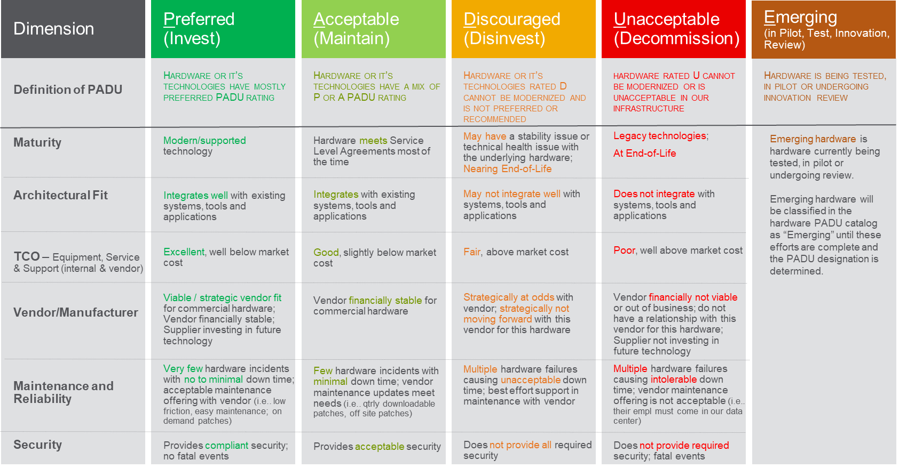
Hardware PADU Criteria
25

